Slide 1
Generalizability of prediction models
How well does a prediction model perform in a target population that differs from the population originally used for model development and/or evaluation.

Slide 2
Datasources
Framingham study data
Data from NHANES

Slide 3
Objectives
Evaluate performance of a cardiovascular risk prediction model in a target population underlying NHANES (the focus should not be on the model building or getting the optimal model).
Conduct the same analysis when the target population is simulated.

Slide 4
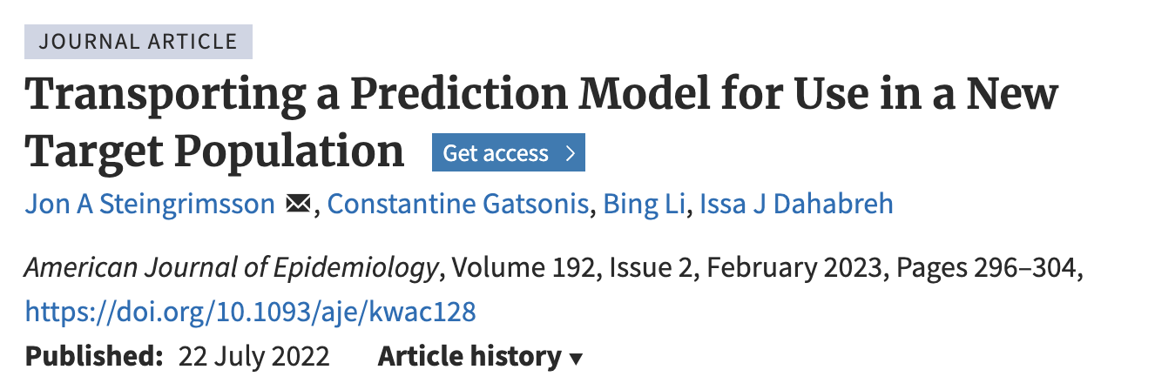
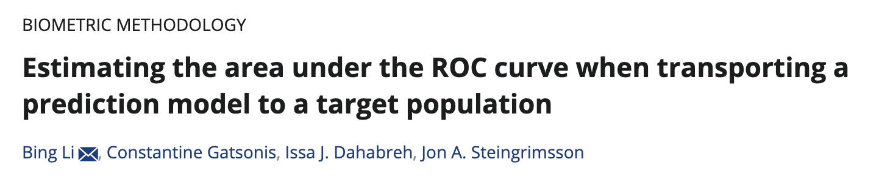
Transportability analysis
Useful references for i) Brier score (MSE for binary outcome) and ii) AUC

Slide 5
Process
Create a combined dataset from Framingham study data and NHANES data (with the outcome only being available in the Framingham study).
Find the variables that are common in both studies
Find the subset of the NHANES data that meets the eligibility of the Framingham study (to the extent possible).
Either use an already existing model or build and evaluate a model (test and training).
Estimate how that model performs in the NHANES target population .

Slide 6
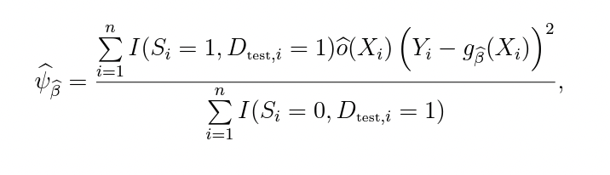
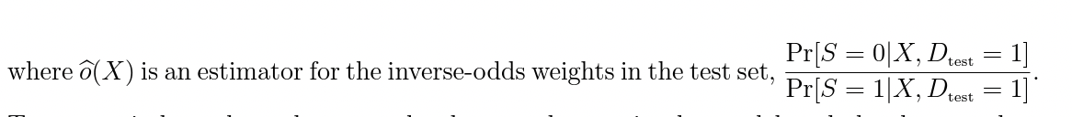
Formula for transportability analysis
Notation:
Y outcome
X covariates
S population indicator (S=1 if in Framingham study and S=0 if in NHANES)
g(X) a prediction model for Pr[Y=1|X, D=0].
D indicator if in test set (if you are using a split into train and test set)
Estimator for Brier risk in
target population

Slide 7
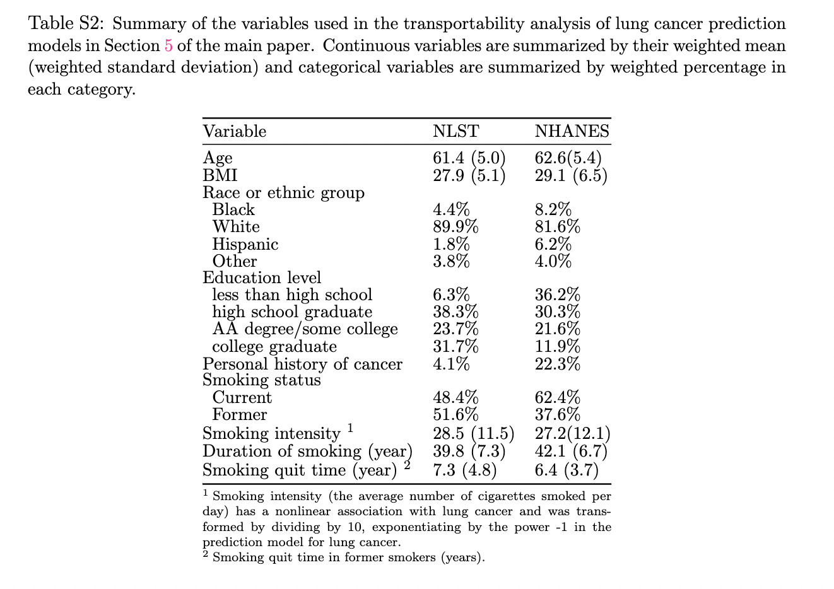
Simulations
Now assume that individual level data is not available from the target population and only summary statistics are available. Example from a different dataset below.

Slide 8
Simulations
Use such summary level data to simulate individual level data from the target population and conduct the transportability analysis using this simulated dataset. This will give one estimator of model performance in the target population.
Across simulations, compare the simulated transportability analysis to the non-simulated transportability analysis.

